Slide 1
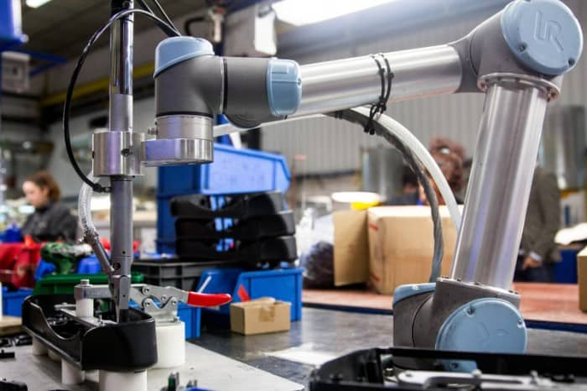

CSC485B Machine Learning for Robotics
SUNY Plattsburgh
Dr. Ned Lecky
Class 03- Some Unusual ML Examples

Slide 2
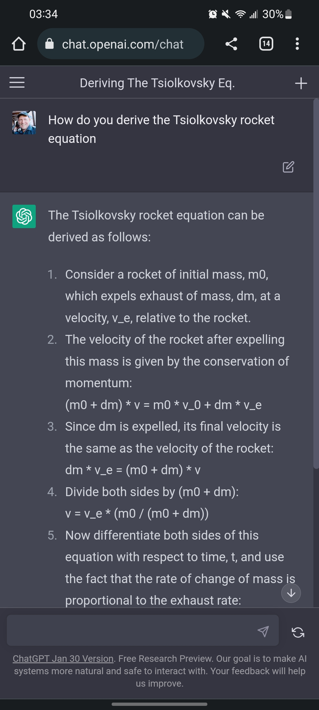
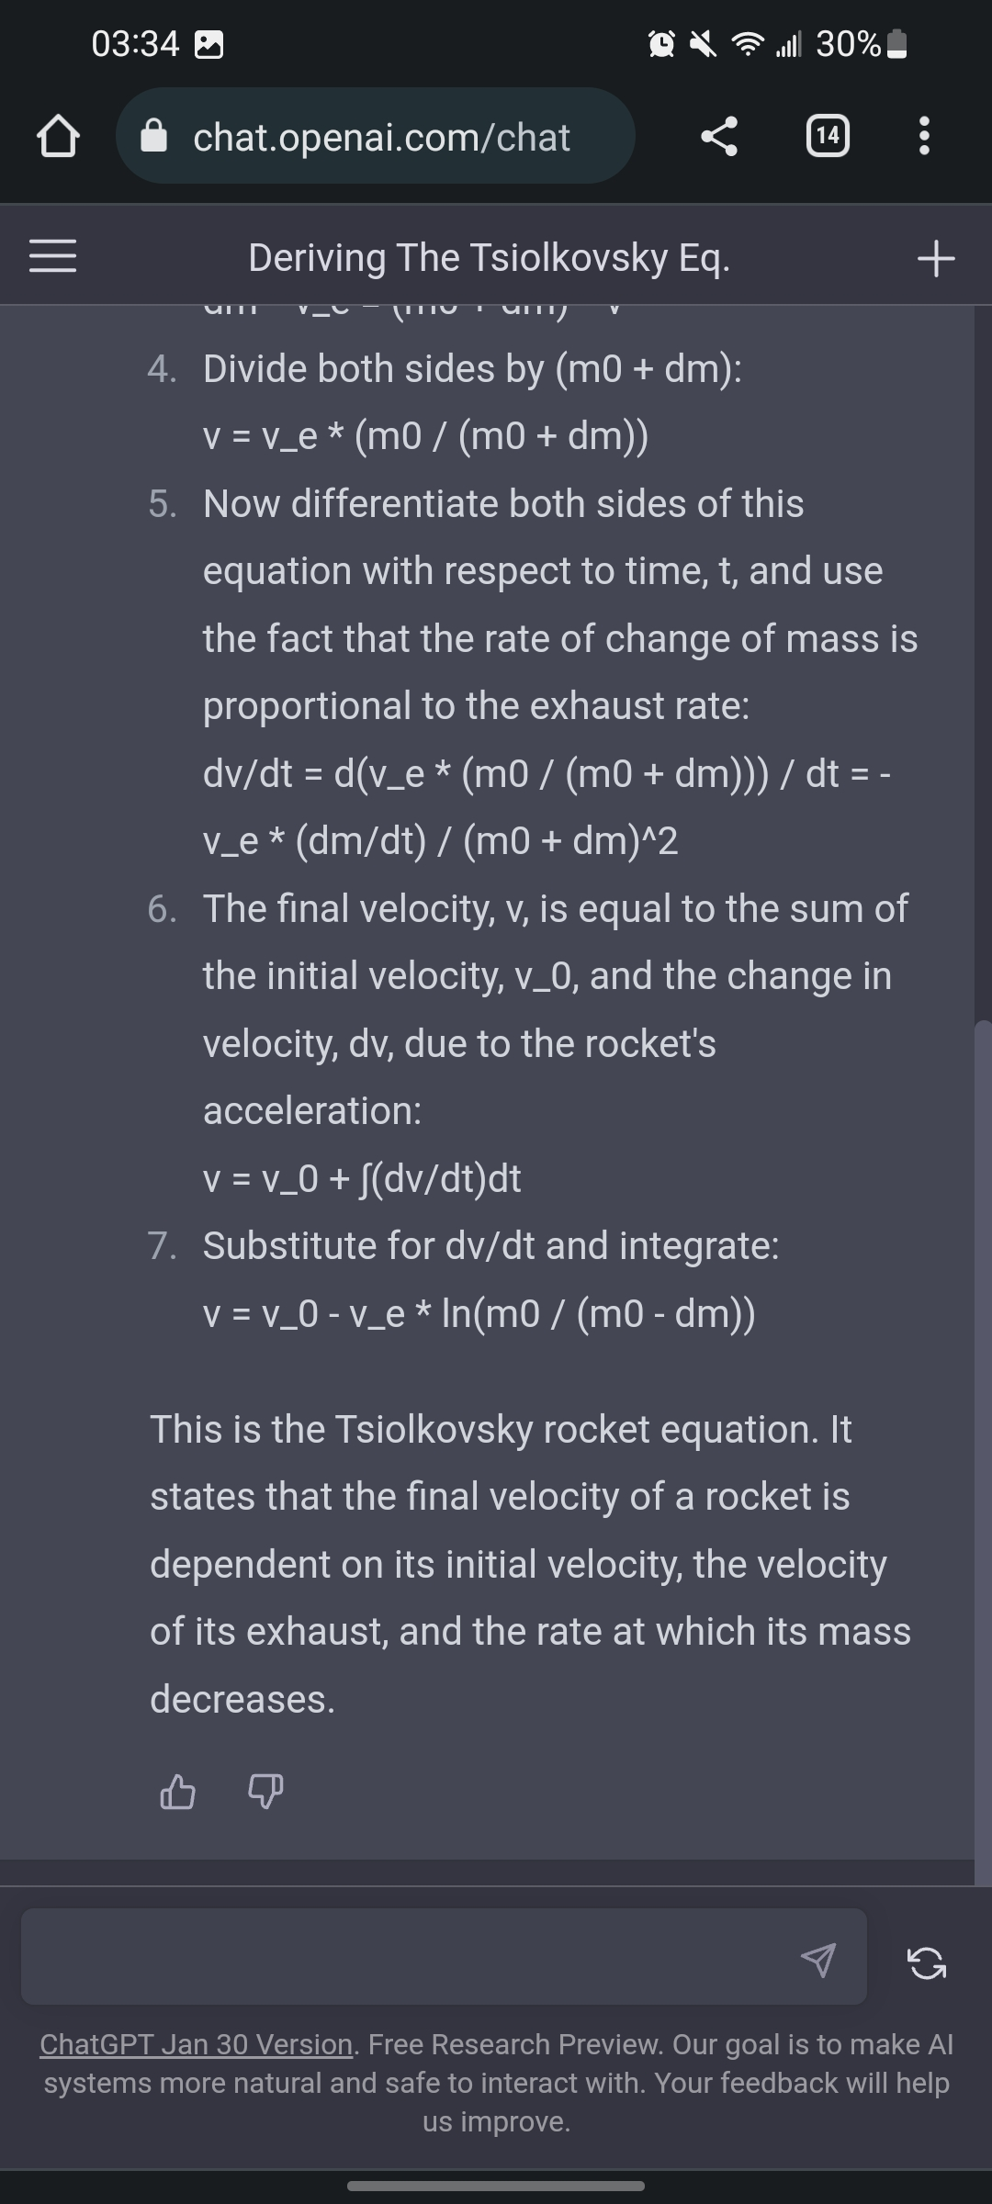
Some Funny AI Asides
Pretty much nonsense from step #3 onward, and with an incorrect result.

Slide 3
Today
Let’s get into ML code, some robotics-related datasets, and some very basic initial examples

Slide 4
Teaching ML
Most books tend to use canned datasets that don’t resonate with our own problems
Iris
California Housing
Titanic passengers, etc.
We are focused on Robotics Applications of AI/ML, so these aren’t useful
AND if you’re interested in seeing how they are used there are ENDLESS books, articles, etc. showing how to use them
So, I am going to deviate from those and use datasets that may seem weird or trivial or otherwise, but these are going to be more like what we might encounter in daily robotics applications

Slide 5
Classification and Regression
Everyone starts with classification, so we will start with…
Regression
Instance Based
Model Based
Supervised
Classify
Unsupervised
Predict
Linear Regression
Polynomial Regression
Decision Trees
Support Vector Machines
Artificial Neural Networks
Perceptron, Adaline, MLP, General DL NN
Reinforcement
Reduce Dimensions

Slide 6

Regression
X
F
Y
Estimate one or more dependent variables based on one or more independent variables
SISO: $y = f(x)$ from days of yore
$y = 13.2x + 17$, $y = 3x^{2}+5x−8$, $y=13\sin\left(x\right)−14e^{−x}$
MISO: Generalize for multiple inputs (a vector)
$y = f($x$)$ (see the BOLD?)
$x= [x_{1},x_{2}{,x}_{3}, …]$, $y = 3{x_{1}}^{2}+5{x_{2}}^{2}+2x_{1}−8$
MIMO: And for multiple outputs
$y=\left[{y_{1} \atop y_{2}}\right]=\left[{3{x_{1}}^{2}+5{x_{2}}^{2}+2x_{1}−8 \atop 6{x_{1}}^{2}+2{x_{2}}^{2}−x_{1}+3 }\right]$
Since y in general depends on powers of x, this is NOT linear algebra and can’t be expressed as tidy matrices

Slide 7
Prediction: Say No to Nostradamus
Predicting the stock market and wine quality and housing prices and weather involves looking at past data and predicting the future
In most real situations, the new and unknown changes brought by the future are just as influential as the old data
I call this the Nostradamus Problem
Predicting the future does not work any better than guessing (in the long run)
Fortunately, in robotics, we have a lot of situations that are much more predictable
If you can model it in the real world over a reasonable time period now, there isn't that much reason to expect that things will wildly deviate in the future
Parameters can slowly change, for example grease can thin and magnets and motors can weaken, and gears can get worn…
We can imagine an online learning or continuous learning approach where we could be rebuilding our training sets and improving our models for growing our models into the future without stepping over The Nostradamus Line

Slide 8
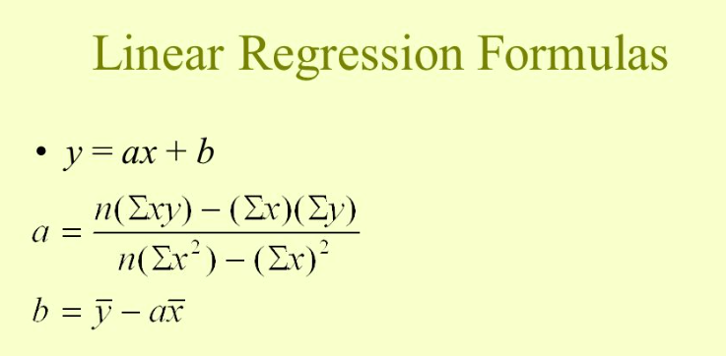
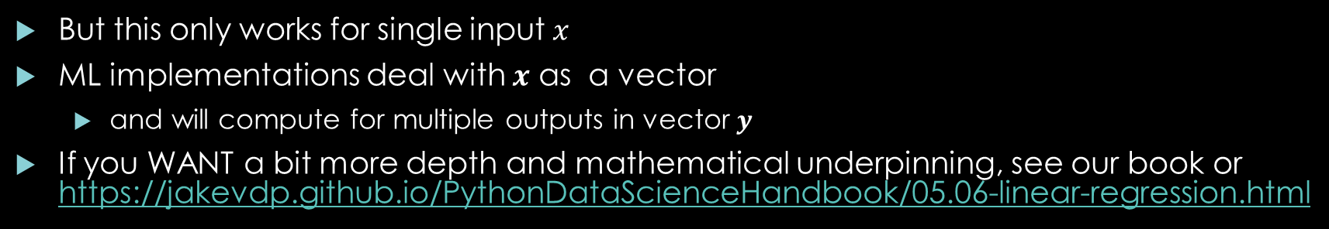
You may have seen…..
But this only works for single input $x$
ML implementations deal with $x$ as a vector
and will compute for multiple outputs in vector $y$
If you WANT a bit more depth and mathematical underpinning, see our book or https://jakevdp.github.io/PythonDataScienceHandbook/05.06-linear-regression.html

Slide 9
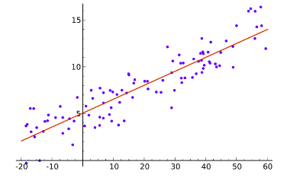

MAAAAAAAATH! No worries.
Much of engineering, physics, and science involves learning how to calculate formulas relating $y$ to $x$
Sometimes based on physical principles and calculus and algebra
$F=ma$, $x= x_{0}+v_{0}t+\frac{1}{2}at^{2}, etc.$
Sometimes based on empirical data and guessing the form of the equation
Linear Regression, single input x, single output y

Slide 10
What is this useful for? Well, to start…
Camera calibration: lenses distort in funky ways and things move
Interscan 1500 Calibration: 1 dot and a robot
Vision Calibration (Funky trig plus optical distortion)
Converting several odd-angle measurements to real-world data
Robot Speed Calibration
Cyline: calibrating motion speed on cylindrical objects using a standard robot
Robot Vision to Motion Calibration
BrightonBeachLab: a 6DOF calibration from 2 cameras to robot movements
Friction to help with part handling, gripping, part rejection mechanisms….
Way mysterious and lots of independent variables
https://www.20sim.com/webhelp/modeling_tutorial_friction_staticdynamicphenomena.php
Fluid Dispensing
Fluid flow rate changes with temperature, time, and voltage or current on a dispensing plunger
Optical Character Recognition
Agent-based Modeling, Cellular Automata
Complex behaviors from simple rules that defy direct mathematical description (NetLogo Ants)

Slide 11
So, what are WE doing?
Learn or Estimate the functions from data
We’re going to use regression library functions
All will accept one or more inputs and generate one or more outputs
All live in scikit-learn
Linear Regression (which handles MIMO)
Polynomial Features (which helps Linear Regression do a little bit of non-linear regression
Decision Trees… a bit of a blunt instrument but interesting
Artificial Neural Networks: We’ll look at the Multilayer Perceptron (MLP) which does 90% of what any other ANN or Deep Neural Network can do
Eventually we’ll see more performance in Keras/TensorFlow or Haiku/Jax or…

Slide 12
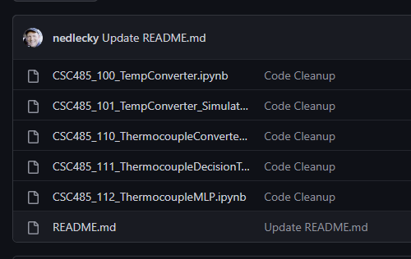
Into the Maw
Let’s start building up some simple ML models using sklearn
These are funky examples that you won’t see anywhere else!
https://github.com/nedlecky/CSC485B

Slide 13
Next
A more complex example from my time at Google and DeepMind
Brighton Beach Lab
https://sites.google.com/lecky.com/brighton-beach-lab/home

